Slide 1
Do Artifacts Tell Stories?
First World War Educational Programming

Slide 2
The Big Six: Evidence and Interpretation
Generating/finding Evidence and perceiving Interpretations require an analysis of primary and secondary sources (Dr. Lindsay Smith Gibson).
This process allows us better understand historical events and occurrences (Dr. Lindsay Smith Gibson).
Looking at evidence from the past allows students to generate stories from the past (The Big Six, p. 2).

Slide 3
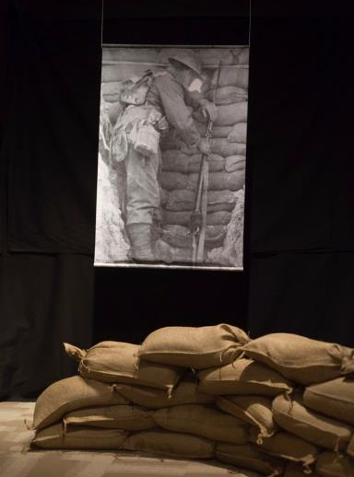
Artifacts
Artifacts tell stories and add to the historical narrative created by museum exhibits.
Artifacts humanize history by connecting information with items from the period or era discussed.
Artifacts make the experiences they represent more tangible to visitors.
Objects convey information and stories to the visitor that written history can not.

Slide 4
Your Task
You will spend 10 minutes per station with two artifacts, and then switch to the next station.
Your group will:
Evaluate the artifacts.
Draw a picture that represents the artifacts.
Answer the questions associated with the analysis sheet.

Slide 5
Trench Artifacts
The goal of trench warfare was to defend one’s trench while attempting to take the enemy’s line.
Many new technological inventions and innovations were developed during the First World War.
Use the gas masks and helmet to answer the questions present on the artifact analysis sheet.

Slide 6
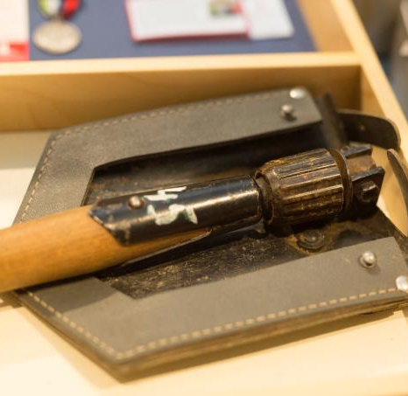
Trench Tools
New and powerful weapons came out of the First World War. Trenches served as protection from the enemy line.
Examine the trench tools and fill out the artifact analysis sheet.

Slide 7
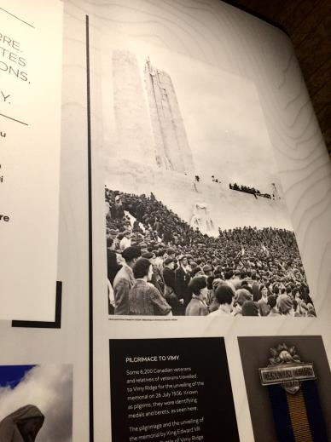
Vimy Monument
The Vimy Monument is highly recognized and has become a symbol of Canada.
The monument was unveiled in 1936.
In 1922, the French government gave land to Canada in honour the Battle of Vimy Ridge.
There are 11,285 names of the Canadians who died in France during the First World War.
Using the artifact sheet, do an analysis on this monument.

Slide 8
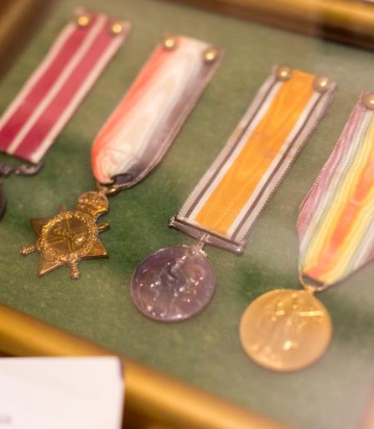
Medals
These medals are typically associated with military service, however, it also represents outstanding acts of citizenship (Veterans Affairs Canada).
Using the artifact sheet, do an analysis on the medals and memorial penny.

Slide 9
Uniforms
Uniforms distinguish the representation of the country that soldiers belongs to.
Puttees were designed to help soldiers remain cleaner, and warmer, due to conditions of the trenches.
Answer the questions on the artifact analysis sheet to critically think about uniforms.

Slide 10
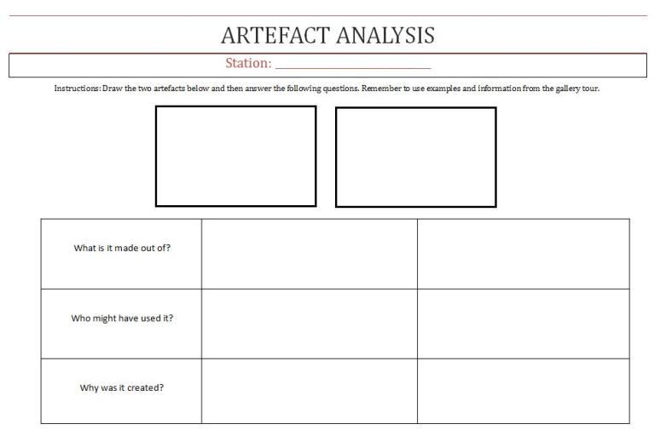
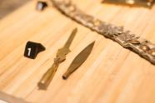
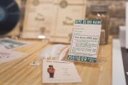
Grades 4-8
Trench Art
White feathers
Bits of brass
Made by soldiers, POWs and villagers.
Females at the University of Saskatchewan
They served as decorative pieces however; some were used as practical pieces.
Some female students harassed males that did not enlist, waving white feathers in their face and taunting them as cowards as they walked by – the “White Feather Movement.”

Slide 11
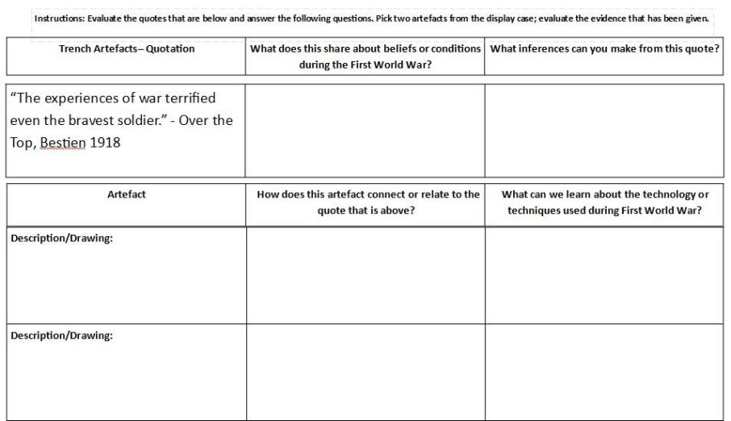
Grades 9-12
In the begining, war was romanticized. As war went on, people started to realize the horrible conditions that soliders were facing. Especially in trench warfare.
I can infer that conditions were horrible throughout war. Even the bravest soliders experinced conditions where they witnessed death, torture, and suffering.
The death penny was given to the family members of soliders who was killed in battle. This represents the bravery that soliders dedicated in battle, which cost this solider their life.
I can learn that bravery can be represented in a form of a medal. This was used to represent the dedication that one person showed to their country.
Death Penny

Slide 12
Conclusion
Why is it important to use evidence as a way to discover historical stories?
How this activity helped you to understand First World War?
What did you discover from looking at these artifacts?

